Slide 1
Environmental Monitoring: Protecting Our Planet
Subtitle: An overview of the importance and methods of environmental monitoring
Team Members
P.Gomathy
R.Gurunathan
E.Ashokbharathi
J.Kalanithi
S.Priyadharshini
S.Sugumaran

Slide 2
Introduction
Content:
Briefly introduce the topic of environmental monitoring.
Mention the significance of monitoring our environment.
State the objectives of the presentation.

Slide 3
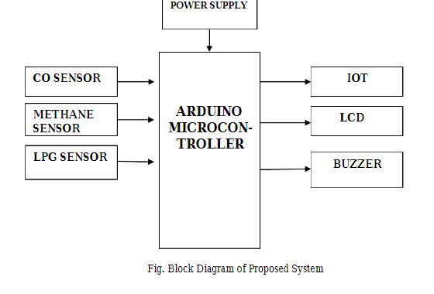
BLOCK DIAGRAM

Slide 4
In this proposed model the climatic changes are frequently monitoring through IOT using sensor nodes. Internet of
Things (IoT) is a recent communication paradigm, in which the objects will be equipped with microcontrollers,
transceivers and suitable protocol stack that will make them to communicate with one another and with user. This
paper designs a prototype of wireless environmental monitoring system to upload information from array of sensors
to the database. This application allows us to observe or measuring the environmental parameters from anywhere in
real time. This system consist of main three modules namely sensor nodes, the wireless communication and the
web server. The sensor nodes in remote location collect the information from surrounding environmental
conditions and send the data wirelessly using Arduino microcontroller and ESP8266 Wi-Fi module to the server.
This paper presents a system that can be used to measure the toxic gases in surrounding area like Industrial area by

Slide 5
using various sensor nodes. All sensors are connected on the arduino microcontroller and the status of the sensors is
send to the control section continuously. The data uploading is done by ESP 8266 Wi-Fi module. The data is
updated on internet. The values of sensors are displayed on LCD. The buzzer is used to make sound, if the sensor
beyond its threshold value for saving the people immediately. The device developed in this project is based
Arduino UNO. The Arduino board connects with Thing Speak platform using ESP8266 Wi-Fi Module. The Thing
Speak is a popular IOT platform which is easy to use and program. The sensor data is also displayed on a character
LCD interfaced in the monitoring IOT device. The sensing of data and sending it to the Thing Speak server using
Wi-Fi module is managed by the Arduino Sketch. The Arduino sketch is written, compiled and loaded to the
Arduino board using Arduino IDE.

Slide 6
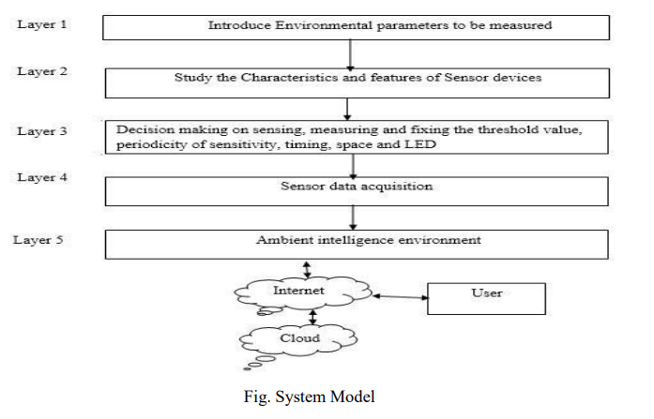

Slide 7
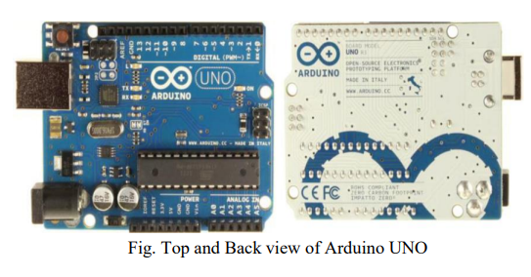
From the above model, process is divided in 5 layers. The environmental parameters which are to be measured are introduced in layer 1. Study of the characteristics and features of sensor devices is in layer 2. In layer 3, there is decision making on sensing, measuring and fixing the threshold value, periodicity of sensitivity, timing, space and LED.
Sensor data acquisition is done in layer 4. And layer 5 as ambient intelligence environment. The sensors can be operated by the microcontroller to retrieve the data from them and it processes the analysis with the sensor data and updates it to the Internet through Wi-Fi module connected to it. User can monitor the parameters on their smart phones as well as pc or laptop

Slide 8
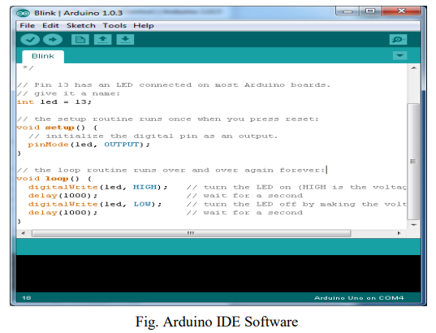
ARDUINO IDE

Slide 9
THINGSPEAK
Thing Speak is the cloud based web server for IOT Applications. It is an open source. In which we created our own channel for IOT based Environmental monitoring by providing username and password. The output is obtained by setting the number of field we required for monitoring the Environment parameters. Then the sensors values are updated to the server using ESP 8266.It provided the graph to show the density of gases in the air.

Slide 10
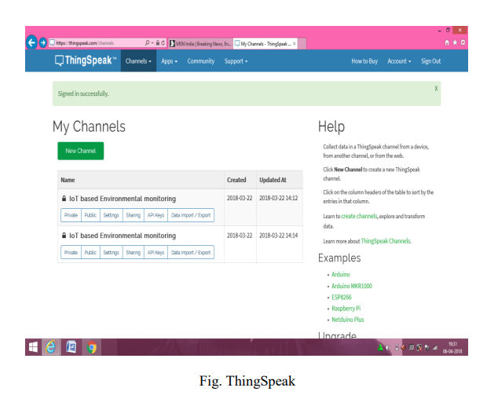

Slide 11
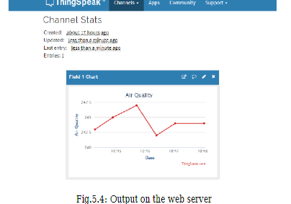
OUTPUT ON THE WEBSERVER

